Slide 1
CUEVO Lyrics
Time-synced song lyrics, straight into Resolume Arena over Spout
v0.11.0 · first public release MIT licence · github.com/mochaheree/cuevo-lyrics

Slide 2
The problem
02
Putting lyrics on a live screen usually means one of two bad options.
Pre-rendered video
Every song becomes a render job. Change the set list an hour before doors and you are re-exporting.
Type it live
Someone is typing into a text source while the band plays. It shows.
Presentation software
Built for slides, not for a VJ rig. Getting it into Resolume with real alpha is a fight.
CUEVO Lyrics does the third thing properly: a lyrics engine that speaks Resolume natively.

Slide 3
What it is
03
A desktop app that renders lyrics and hands them to Resolume as a Spout source with real transparency.
Search or write
Pull synced lyrics from LRCLIB, import .lrc, or time them yourself with a tap-to-timestamp editor.
Build the set
Order the songs, save the show, reopen it next week.
Style it once
Font, size, colour, outline, scroll behaviour, transitions. Save as a template.
Run the show
Play, pause, nudge the sync, blank the output. Keyboard, OSC, or MIDI.

Slide 4
How it works
04
1
LRCLIB / local library / manual editor
where the words come from
2
LRC parser
lines plus timestamps
3
Show
the running order
4
Live control
play, pause, offset, blank
5
Renderer
multi-line scroll, transparent RGBA
6
Spout
Resolume: Sources > Spout
Sync is manual by design. You press Play when the song starts and nudge it if it drifts. No audio listening, no beat detection, nothing to go wrong in front of an audience.

Slide 5
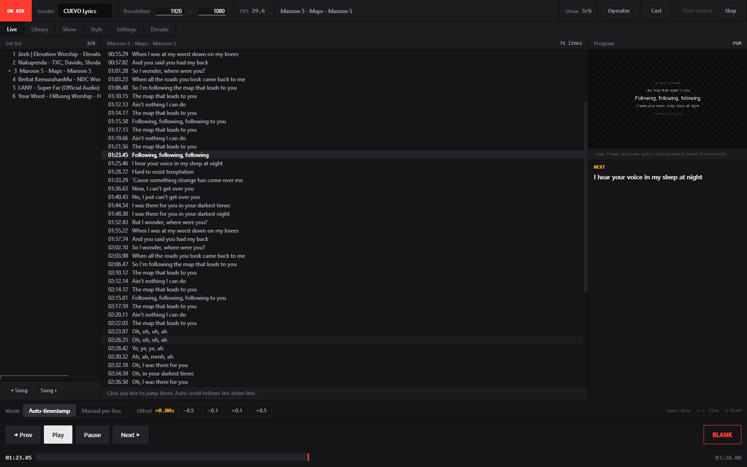
Live
05
Live
Set list, the full lyric sheet, and a preview of exactly what Resolume is receiving. The strip reads ON AIR at 29.7 fps, measured, not decorative.

Slide 6
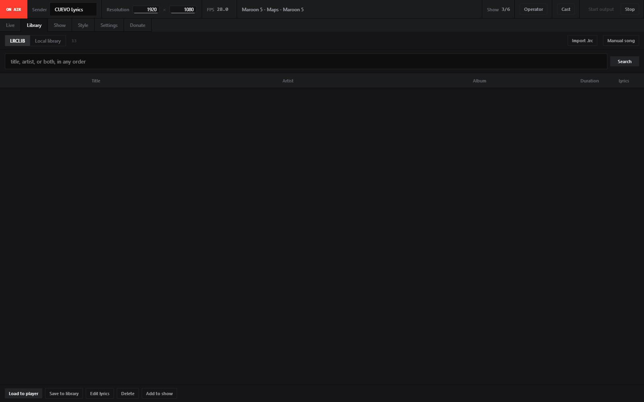
Library and Show
06
One search box
Title, artist, or both, in any order. It maps to LRCLIB's own query parameter.
Works offline
Once a song is saved locally, LRCLIB being down does not stop the show.
Manual editor
Tap to timestamp, shift every line at once, export .lrc.

Slide 7
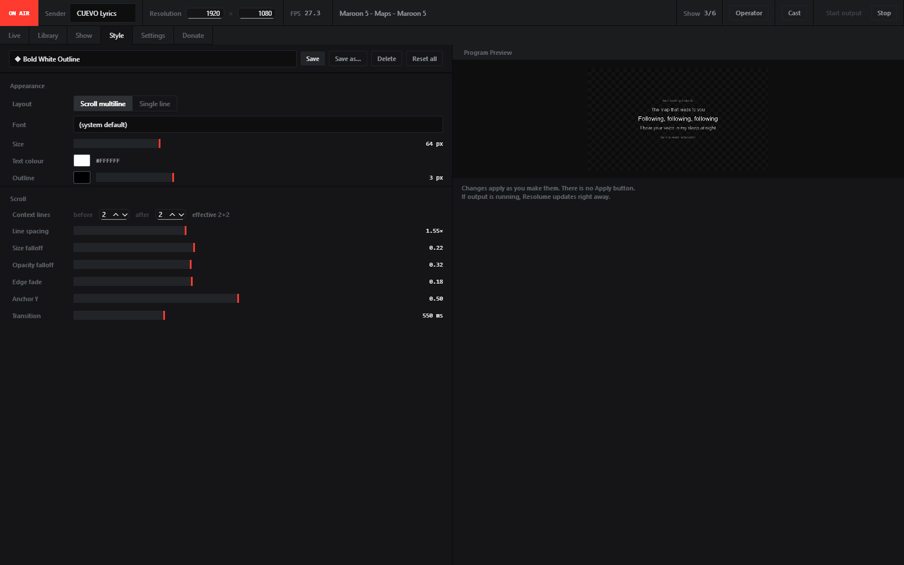
Style
07
Style
Every visual parameter, live as you drag. Right-click any control to reset it, the way Resolume Arena behaves. Save the result as a template.

Slide 8
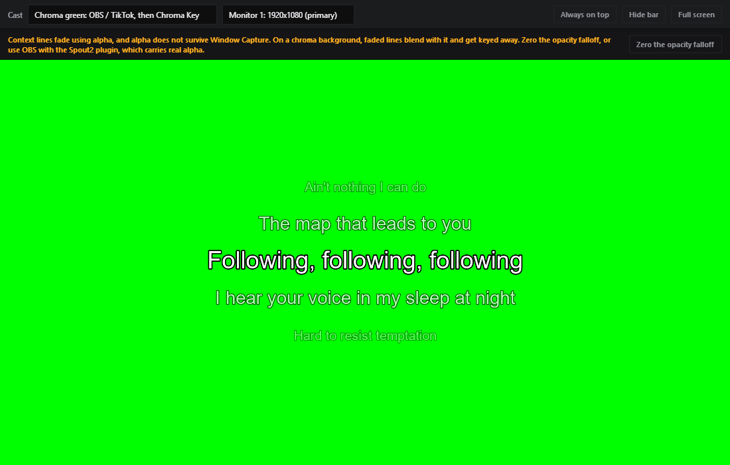
Cast: OBS, TikTok Live, second screen
08
Cast: OBS, TikTok Live, second screen
One window covers all three, because all three want the same thing: something capturable. Note the warning: alpha does not survive Window Capture, so the app detects it and offers the fix.

Slide 9
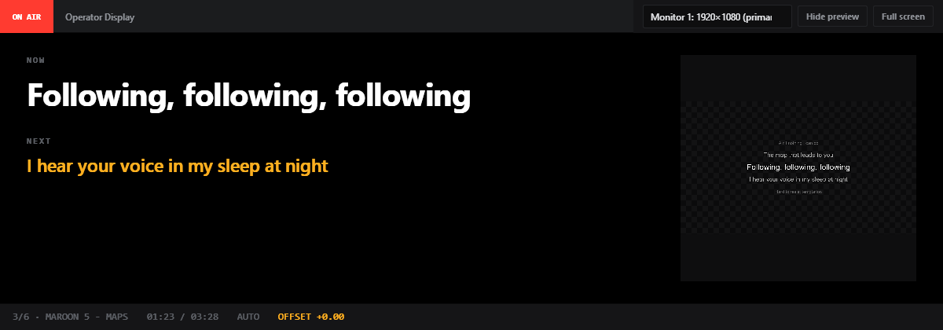
Operator Display
09
Operator Display
NOW and NEXT on a second monitor, for whoever is calling the show. Position, elapsed time, mode, and sync offset along the bottom.

Slide 10
Measured, not claimed
10
29.7 fps
26.0 ms
9.3 ms
18 to 40 ms
worst case, 1920x1080
per frame, median
outline render, was 137 ms
style change to on-screen
Lines changing every 0.6s so the frame cache never helps
Against a 33.3 ms budget for 30 fps. 22% headroom
Brute-force outline replaced with Pillow stroke_width
Style swaps without stopping the output
Every number here came from running the thing on Windows 11 with Resolume open. The full test transcripts are in SRS.md.

Slide 11
What it does not do
11
Stated up front, because finding out during a show is worse.
No audio analysis
Sync is manual. This is a design decision, not a missing feature.
Spout is Windows only
The rest of the app runs anywhere, but output does not.
OSC and MIDI are untested on hardware
The code is there and it is documented as unverified. If you have a controller, please open an issue.
Not code signed
Windows SmartScreen will warn on first run. The source is public so you can build it yourself.

Slide 12
Get it
12
Download
github.com/mochaheree/cuevo-lyrics/releases
Source
github.com/mochaheree/cuevo-lyrics
Licence
MIT
Lyrics come from LRCLIB, which is community contributed. This project does not host or claim rights to any lyrics. Check the licensing of anything you put in front of a paying audience.

